Slide 1
Supporting Teachers during Collaborative Learning Using MMLA and AI
Pankaj Chejara, Reet Kasepalu
14.09.21

Slide 2
Research Problem
Collaboration is 21st Century skill (Voogt & Robline, 2012; Ananiadoa & Claro, 2009) and Collaborative learning has been found to have positive influence on learning (Laal et al., 2012)
Students do not know “How to collaborate effectively?” (Le el al. 2017).
Students do not learn this skill if left alone in collaborative activity (Stover & Holland, 2018)
It can be difficult for teachers to know for each group in the classroom “what is going on in the group?” (Alavi et al. 2009; Lui & Nesbit, 2019).
Observation based methods have scalability issues.
Support teachers in monitoring and understanding the small group collaboration in classroom settings
Notes:
Add references to Alavi, Le citation.

Slide 3
Collaboration
“a situation in which two or more (i.e. a pair, small group, a class, community, society, and all intermediate level) attempts to learn something (i.e. follow a course, study course material, perform learning activities, learn from lifelong learning practice,..) together (i.e. face to face or computer mediated, synchronous or not, frequent or not, whether it is a truly joint effort or whether the labour is divided in a systematic way)”.
(Dillenbourg, 2007)
Communication
Sustaining mutual understanding
Dialogue management
Information pooling
Joint information processing
Reaching consensus
Task division
Collaboration
Coordination
Time management
Technical Coordination
Interpersonal relationship
Reciprocal interaction
Motivation
Individual task orientation
(Meier et al., 2007)

Slide 4
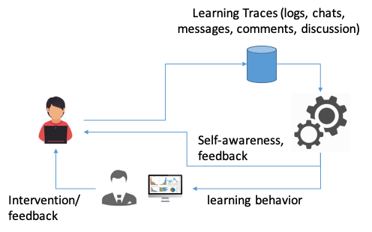
Learning Analytics
Some of mental processes are externalized during collaboration through dialogue, writing, argument, drawing (Stahl, 2006)
LA is defined as “the measurement, collection, analysis and reporting of data about learners and their contexts, for purposes of understanding and optimizing learning and the environments in which it occurs”.
(Society of Learning Analytics, 2011)
Researcher often looked on computer mediated interactions while ignoring real-world environment. (Ochoa et al., 2017)

Slide 5
Multimodal Learning Analytics (MMLA)
Multimodal Learning Analytics sits at the intersection of three ideas: multimodal teaching and learning, multimodal data, and computer-supported analysis.
(Worsley et al. 2016)
Motion tracker
Video
Physiological
Logs
Audio

Slide 6
Related work
Specification of type of problem
Data collection
Data annotation
Feature extraction
Feature fusion
Model training & evaluation
Classification
Physiological
Standard rating scheme
Heart rate
PCA
SVM
Random forest
Regression
Logs
Clickstream
Speaking time
Entropy
K-means
Naive Bayes
Self-devised scheme
Turn-taking
Gini
AdaBoost
Neural net
Pattern recognition
Audio
Video
Acoustic
Decision tree
Linguistic
Body movement
Eye movement
Emotion
The majority of the study is conducted in laboratory settings.
Inconsistent way of model evaluation.
Model does not offer rationale for estimated outcome.

Slide 7
Main idea
Multimodal data
Model of collaboration
MMLA System
Teacher
Collaborative activity

Slide 8
Research gaps & objectives
is intelligence amplification in the classroom increasing the awareness of the teacher?
Lack of standard practice to evaluate MMLA (ML) solution
Lack of technological MMLA (ML) support for CSCL that support estimation with underlying reason
Gaps
Lack of studies in authentic settings, would this really be useful in real classrooms with real teachers?
Is intelligence amplification in the classroom increasing the awareness of the teacher?
To build and assess ML-based MMLA technological support for estimation of collaboration quality and its sub-dimensions in small groups in classroom collaborative learning environments.
Objective
Systematize the evaluation of MMLA (ML) solution for their generalizability in MMLA context
Develop ML approach to estimate collaboration quality and its sub-dimensions
Sub objective
Carry out field experiments with real students and teachers
Compare the results using three conditions:
MMLA, AI and normal

Slide 9
Research gaps & objectives
is intelligence amplification in the classroom increasing the awareness of the teacher?
Lack of standard practice to evaluate MMLA (ML) solution
Lack of technological MMLA (ML) support for CSCL that support estimation with underlying reason
Gaps
Lack of studies in authentic settings, would this really be useful in real classrooms with real teachers?
Is intelligence amplification in the classroom increasing the awareness of the teacher?
To build and assess ML-based MMLA technological support for estimation of collaboration quality and its sub-dimensions in small groups in classroom collaborative learning environments.
Objective
Systematize the evaluation of MMLA (ML) solution for their generalizability in MMLA context
Develop ML approach to estimate collaboration quality and its sub-dimensions
Sub objective
Investigate the teacher’s perception on the MMLA technological support
Compare the results using three conditions:
MMLA, AI and normal

Slide 10
Needs Analysis
What would teachers like to have as a superpower in collaborative learning?
an assistant suggesting methods
having a full overview of the class
seeing how engaged the students are
making everyone contribute the same amount

Slide 11
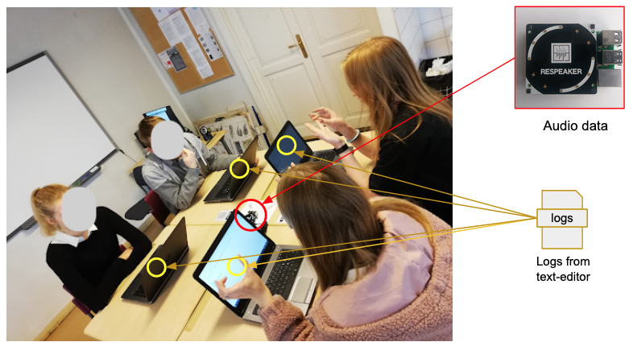
First study
Group | 2
Group-size | 4
Duration | 30 mins
Instances | 121
Computer-Supported Collaborative Learning in Classroom settings
Collaborative text editor (Etherpad) + Raspberry Pi prototype : CoTrack
Trained and evaluated machine learning regression model.
Features (30 sec)
Speaking time
number of char added
number of char deleted
*Chejara P., Prieto L.P., Ruiz-Calleja A., Rodríguez-Triana M.J., Shankar S.K. (2020) CoTrack: Tool to capture collaboration behavior in digital and physical space. In: Learning Analytics and Knowledge, LAK20 (Demo paper)
*Chejara P., Kasepalu, R., Prieto L.P., Ruiz-Calleja A., Rodríguez-Triana M.J., Shankar S.K. (2020) MMLA approach to track collaboration behavior in face-to-face blended settings. In: CrossMMLA Workshop at Learning Analytics and Knowledge, LAK20 (Workshop paper)

Slide 12
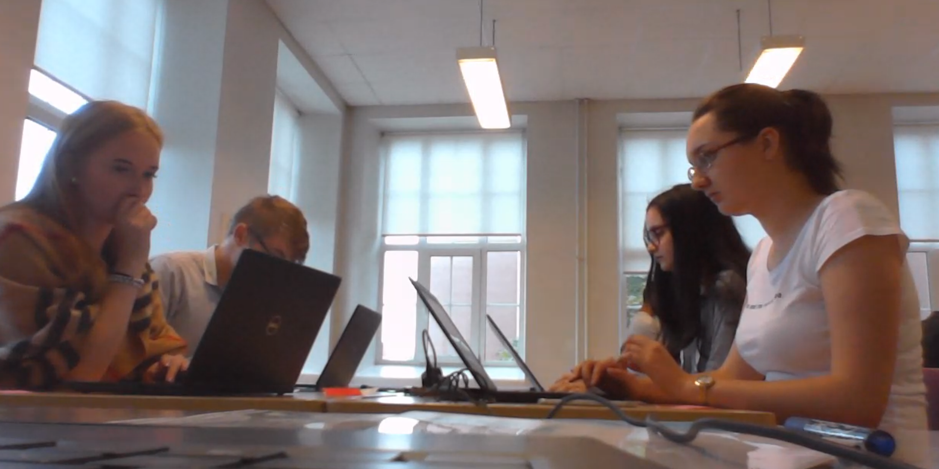
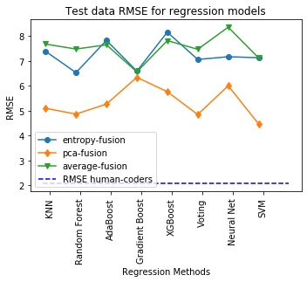
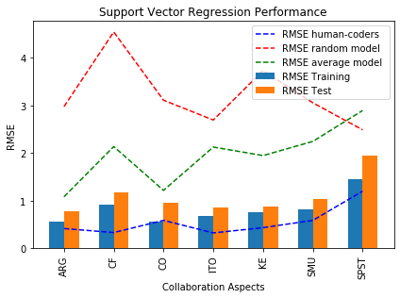
First study
Features
Feature Fusion
PCA, Entropy, Average
Regression Analysis
PCA-fusion performed better.
Chejara P., Prieto L.P., Ruiz-Calleja A., Rodríguez-Triana M.J., Shankar S.K., Kasepalu R. (2020) Quantifying Collaboration Quality in Face-to-Face Classroom Settings Using MMLA. In: Nolte A., Alvarez C., Hishiyama R., Chounta IA., Rodríguez-Triana M., Inoue T. (eds) Collaboration Technologies and Social Computing. CollabTech 2020. Lecture Notes in Computer Science, vol 12324. Springer, Cham. https://doi.org/10.1007/978-3-030-58157-2_11

Slide 13
First study
Overall speaking time of each participant in the selected group.
Network graph generated from the speaking sequence.
Speaking time of each participant for entire duration of the activity
Each participant’s activity for the entire duration of the activity.

Slide 14
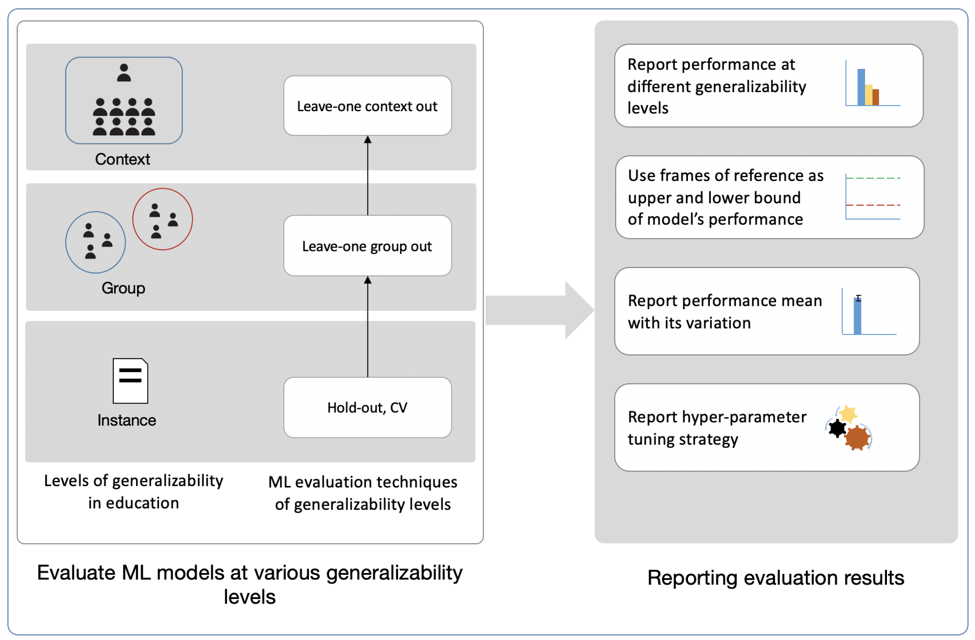
First study
Lack of systematization in machine learning model evaluation in the field of Multimodal Learning Analytics
EFAR-MMLA: An Evaluation Framework to Assess and Report on the Generalizability of Machine Learning Models in MMLA
Chejara, P.; Prieto, L.P.; Ruiz-Calleja, A.; Rodríguez-Triana, M.J.; Shankar, S.K.; Kasepalu, R. EFAR-MMLA: An Evaluation Framework to Assess and Report Generalizability of Machine Learning Models in MMLA. Sensors 2021, 21, 2863. https://doi.org/10.3390/s21082863

Slide 15
Is CoTrack actually something teachers would use?
Wizard-of-Oz: ASSESSING COLLABORATION
Condition 1: using video
Condition 2: using video and MMLA
The teachers
trust the MMLA data rather highly
grew more confident in their decisions
obtaining new information, they did not know how to react
would use it for: seeing the contribution, grading, getting an overview
Kasepalu, Reet; Prieto, Luis; Ley, Tobias; Chejara, Pankaj (2021). Do Teachers Find Dashboards Trustworthy, Actionable and Useful? A Vignette Study Using a Logs and Audio Dashboard. Technology Knowledge and Learning, 1−19. DOI: 10.1007/s10758-021-09522-5 .

Slide 16
Would a Teacher Teach Together with AI?
Wizard-of-Oz: FINDING PROBLEMS; OFFERING SOLUTIONS
Condition 1: video
Condition 2: video and suggestions from the “AI”
The teachers
started employing the coregulation strategies proposed by the AI
came up with more varied interventions after interacting with the AI and did not choose wait-and-see strategy
found the AI helpful
know coregulation strategies, but not implement them in class

Slide 17
Second study: going on
Pandemic
Continuous change in face to face and online learning/teaching
Extending CoTrack features for these new changes
https://www.cotrack.website

Slide 18
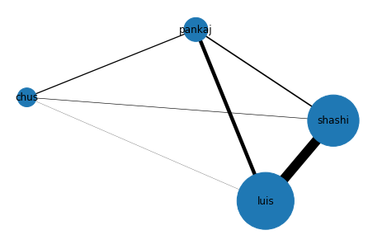
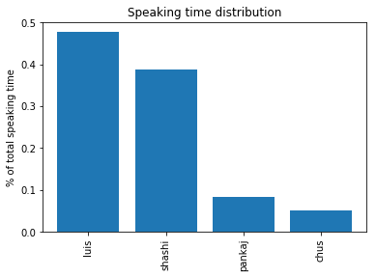
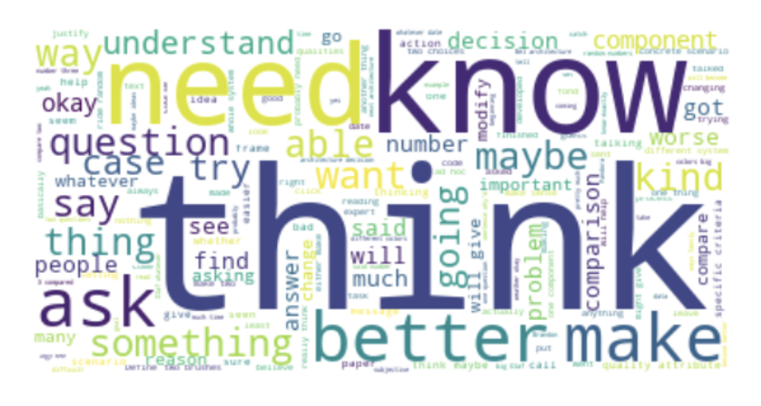
Second study: going on
Online PhD meeting
Real-time monitoring

Slide 19
Second study: going on
1. Identify indicators for various dimension of collaboration.
2. Build machine learning models for level of collaboration and its dimensions.
High
Good
Good
Good
Bad
Equity of participation
Respect others opinion
Medium
Good
Bad
Good
Bad
Low
Group collaboration level
Dimension wise score
Concepts from learning science
Envisioned Visualization

Slide 20
Teacher and AI together- the DREAM TEAM?

Slide 21
THANK YOU!
Pankaj Chejara Reet Kasepalu
pankajch@tlu.ee reetkase@tlu.ee

Slide 22
References
Voogt, J., & Roblin, N. P. (2012). A comparative analysis of international frameworks for 21st century competences: Implications for national curriculum policies. Journal of Curriculum Studies, 44(3), 299–321. https://doi.org/10.1080/00220272.2012.668938
Ananiadou, K. & M. Claro (2009). 21st Century Skills and Competences for New Millennium Learners in OECD Countries. OECD Education Working Papers, No. 41, OECD Publishing, Paris
Laal, M., & Ghodsi, S. M. (2012). Benefits of collaborative learning. Procedia - Social and Behavioral Sciences, 31(2011), 486–490. https://doi.org/10.1016/j.sbspro.2011.12.091
Stover, S., & Holland, C. (2018). Student Resistance to Collaborative Learning. International Journal for the Scholarship of Teaching and Learning, 12(2). https://doi.org/10.20429/ijsotl.2018.120208
Stahl, G. (2006). Group Cognition: Computer Support for Building Collaborative Knowledge. Cambridge, USA: MIT Press
Chua, Y. H. V., Dauwels, J., & Tan, S. C. (2019). Technologies for automated analysis of co-located, real-life, physical learning spaces. LAK19 Proceedings of the 9th International Conference on Learning Analytics & Knowledge, 11–20. https://doi.org/10.1145/3303772.3303811
Ochoa, X. (2017). Multimodal Learning Analytics. Handbook of Learning Analytics, 129–141. https://doi.org/10.18608/hla17.011
Dillenbourg P. (1999) What do you mean by collaborative leraning?. In P. Dillenbourg (Ed). Collaborative-learning: Cognitive and Computational Approaches.
Freedman, D. H. (2010). Why scientific studies are so often wrong: The streetlight effect. Discover Magazine, 26.Retrieved from http://discovermagazine.com/2010/jul-aug/29-why-scientific-studies-often-wrong-streetlight-effect
DiMicco, J. M., Pandolfo, A., Bender, W. (2004). Influencing group participation with a shared display. Proceedings of the 2004 ACM Conference on Computer Supported Cooperative Work - CSCW 04, 614. https://doi.org/10.1145/1031607.1031713
Kulyk, O., Wang, J., Terken, J. (2006). Real-time feedback on nonverbal behaviour to enhance social dynamics in small group meetings. Lecture Notes in Computer Science (Including Subseries Lecture Notes in Artificial Intelligence and Lecture Notes in Bioinformatics), 3869 LNCS, 150161.
Bergstrom, T., Karahalios, K. (2007). Conversation Clock: Visualizing audio pat-terns in co-located groups. Proceedings of the Annual Hawaii International Con-ference on System Sciences, 19. https://doi.org/10.1109/HICSS.2007.151
Spikol, D., Ruffaldi, E., Landolfi, L., Cukurova, M. (2017). Estimation of Success in Collaborative Learning Based on Multimodal Learning Analytics Features. In Proceedings - IEEE 17th International Conference on Advanced Learning Technologies, ICALT 2017 (pp. 269273). https://doi.org/10.1109/ICALT.2017.122
Spikol, D., Cukurova, M., Ruffaldi, E. (2017). Using Multimodal Learning Analytics to Identify Aspects of Collaboration in Project-Based Learning Introduction PELARS system and context. Making a Difference: Prioritizing Equity and Access in CSCL, 12th International Conference on Computer Supported Collaborative Learning (CSCL) 2017, 263270. https://doi.org/10.22318/cscl2017.37
Spikol, D., Ruffaldi, E., Dabisias, G., Cukurova, M. (2018). Supervised machine learning in multimodal learning analytics for estimating success in project-based learning. Journal of Computer Assisted Learning, 34(4), 366377. https://doi.org/10.1111/jcal.12263
Lubold, N., Pon-Barry, H. (2014). Acoustic-Prosodic Entrainment and Rapport in Collaborative Learning Dialogues. Proceedings of the 2014 ACM Workshop on Multimodal Learning Analytics Workshop and Grand Challenge - MLA 14, 512. https://doi.org/10.1145/2666633.2666635
Schneider, B., Blikstein, P. (2014). Unraveling Students Interaction Around a Tangible Interface Using Gesture Recognition. International Conference on Edu-cational Data Mining, (2), 320323.
Bachour, K., Kaplan, F., Dillenbourg, P. (2010). An interactive table for supporting participation balance in face-to-face collaborative learning. IEEE Transactionson Learning Technologies, 3(3), 203213. https://doi.org/10.1109/TLT.2010.18
Terken, J., Sturm, J. (2010). Multimodal support for social dynamics in co-located meetings. Personal and Ubiquitous Computing, 14(8), 703714. https://doi.org/10.1007/s00779-010-0284-x
Isenberg, P., Fisher, D., Paul, S. A., Morris, M. R., Inkpen, K., Czerwinski, M. (2012). Co-located collaborative visual analytics around a tabletop dis-play. IEEE Transactions on Visualization and Computer Graphics, 18(5), 689702. https://doi.org/10.1109/TVCG.2011.287
Stiefelhagen, R., Zhu, J. (2002). Head orientation and gaze direction in meetings. CHI 02 Extended Abstracts on Human Factors in Computer Systems CHI 02, (1), 858. https://doi.org/10.1145/506621.506634
Grover, S., Park, M., Bienkowski, M., Tamrakar, A., Salter, D., & Divakaran, A. (2016). Multimodal Analytics to Study Collaborative Problem Solving in Pair Programming. 516–517.
T.C. Reeves. Design research from a technology perspective. In J. van den Akker, K. Gravemeijer, S. McKenney & N. Nieveen (Eds.), Educational design research, pages 52-66, 2006.
Kharrufa, A., Balaam, M., Heslop, P., Leat, D., Dolan, P., & Olivier, P. (2013). Tables in the wild: Lessons learned from a large-scale multi-tabletop deployment. Conference on Human Factors in Computing Systems - Proceedings, (January 2014), 1021–1030. https://doi.org/10.1145/2470654.2466130

